Slide 1

Hair Dryer Report
Bilal Shabbir
Glasgow Caledonian University
Thursday, November 20, 2025

Slide 2
Table of Contents
General Information
Analysis Summary
Result Advisor
Analysis Conclusions and Recommendations

Slide 3
General Information

Slide 4
Summary – Mesh
Item Name | Item Data
Mesh type | Coarse
Part dimension | 47.95x231.59x210.00 mm
Mold dimension | 47.95x231.59x220.00 mm
Cavity (Part) volume | 108107148.438 mm^3
Number of elements | 310517
Number of part elements | 310517
Number of nodes | 175809

Slide 5
Summary – Material
Item Name | Item Data
Polymer type | PC+ABS
Grade name | BAYBLEND FR 3010
Producer | Covestro
Melt flow index | Unavailable
Fiber percent | 0.00 %
Melt temperature range | 240 ~ 270 °C
Mold temperature range | 60 ~ 80 °C
Ejection temperature | 110 °C
Freeze temperature | 130 °C

Slide 6
Summary – Process
Item Name | Item Data
Filling time | 2.440 sec
Melt temperature | 290.000 °C
Mold temperature | 70.000 °C
Maximum machine pressure | 155.000 Mpa
Packing time | 6.600 sec
VP switch by filled volume (%) | 98.000 %

Slide 7
Analysis Summary

Slide 8
Melt Front Time
Melt front advancement is a position indicator as melt front boundary movement in different time duration in the filling process. From the melt front advancement one can:
Examine imbalances in the filling pattern of the molding.
Check for incomplete filling of cavity or short shot problem.
Identify the weld line locations.
Identify the air trap locations.
Check the flow contribution of each gate for a balanced runner.
Check if the gate location is correct to balance the flow and eliminate weld line.
#PNG_MELT_FRONT_TIME

Slide 9
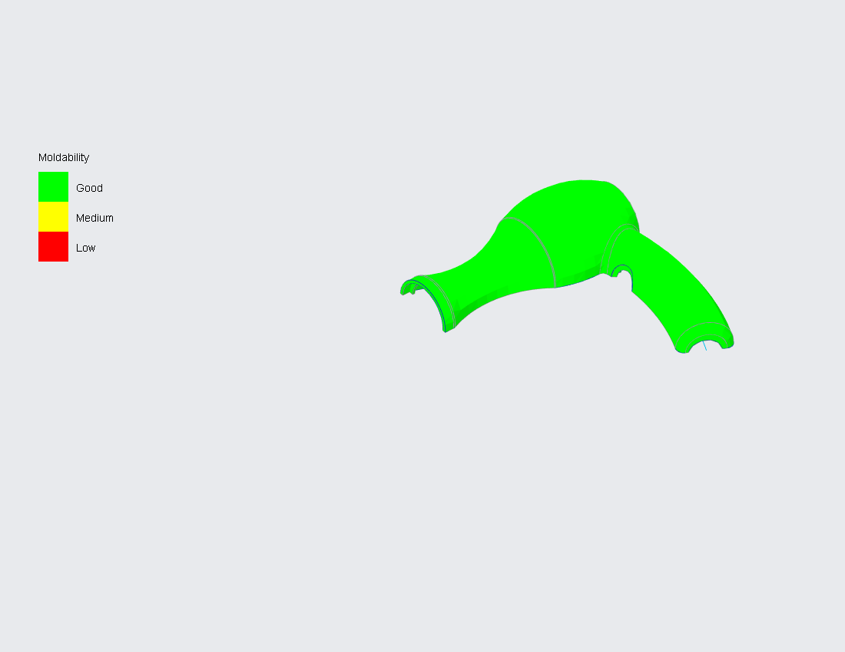
Moldability
The Yellow or Red regions show the areas where the melt filled with difficulty, which could result in quality related problems.

Slide 10
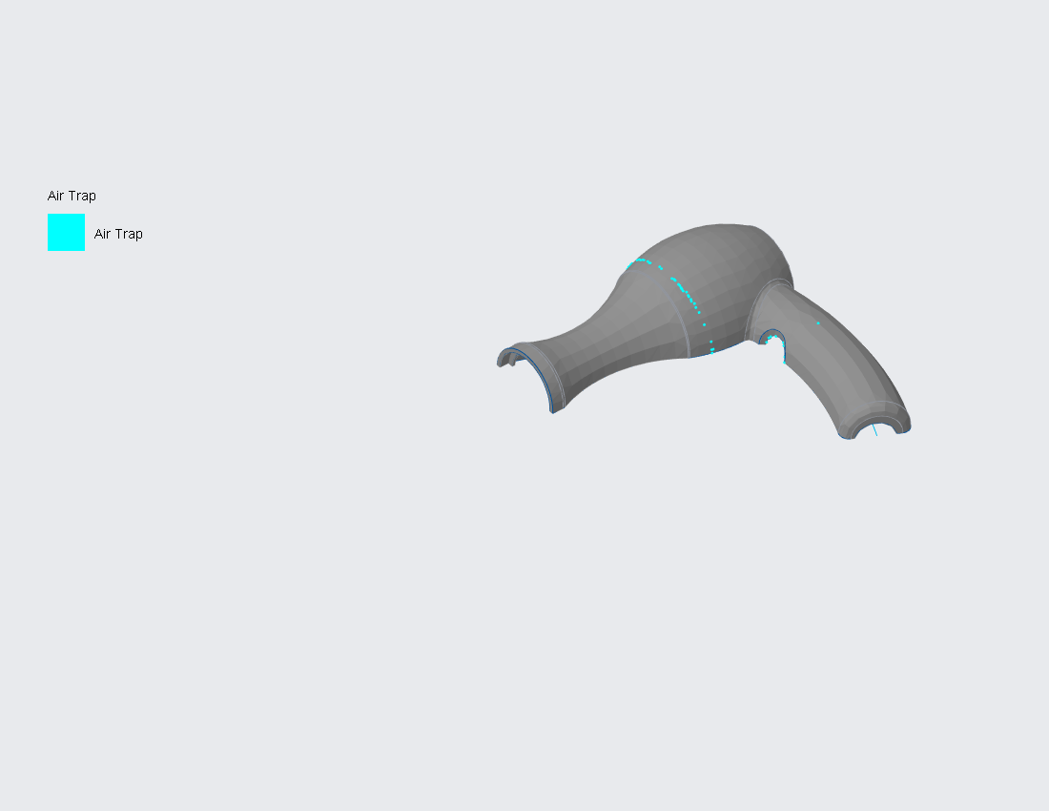
Air Trap
Air Trap result shows the possible locations where air trap can occur.

Slide 11
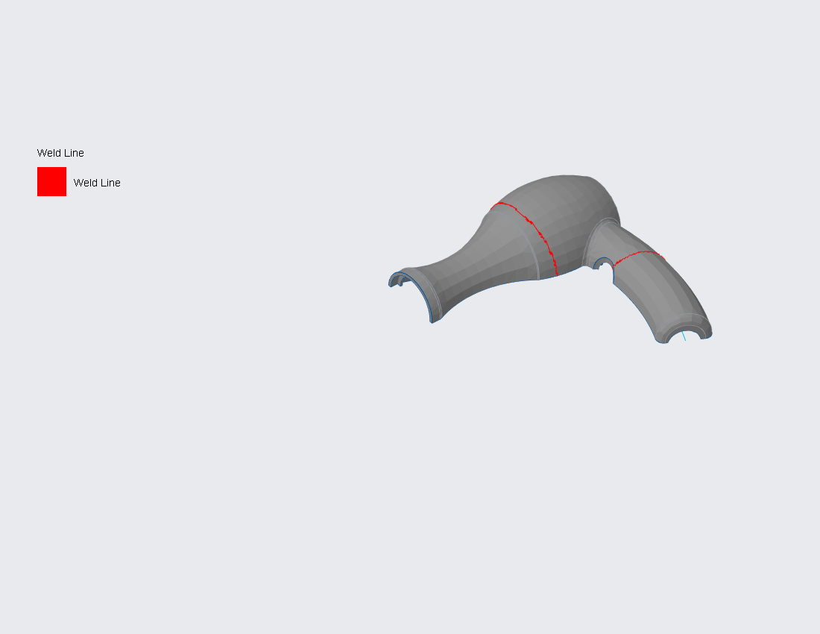
Weld Line
Weld Line result shows the weld lines that indicate potential spots of weaker structure. The darker the weld line, the weaker the structure.

Slide 12
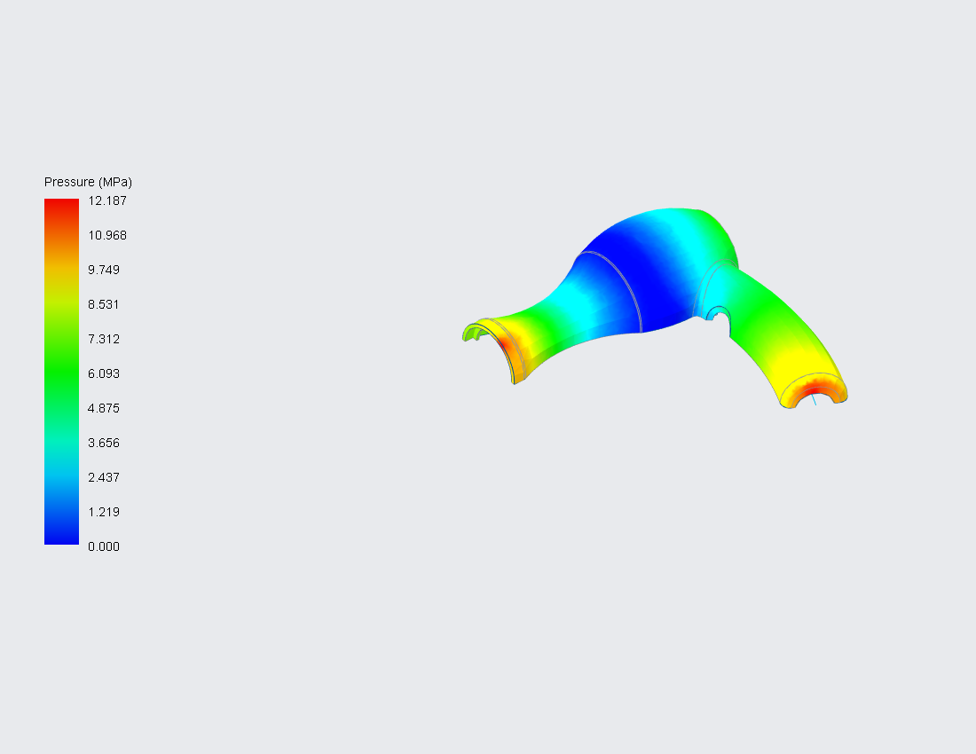
Pressure
Pressure result shows the pressure distribution of the plastic at the end of filling. Use the pressure result to analyze the following:
Check the pressure transmission conditions.
Check for drop in pressure in the runner system.
Check the mold design for a balanced flow.
Check for overpacking and flashing of the melt.
Examine the extent of packing or holding.

Slide 13
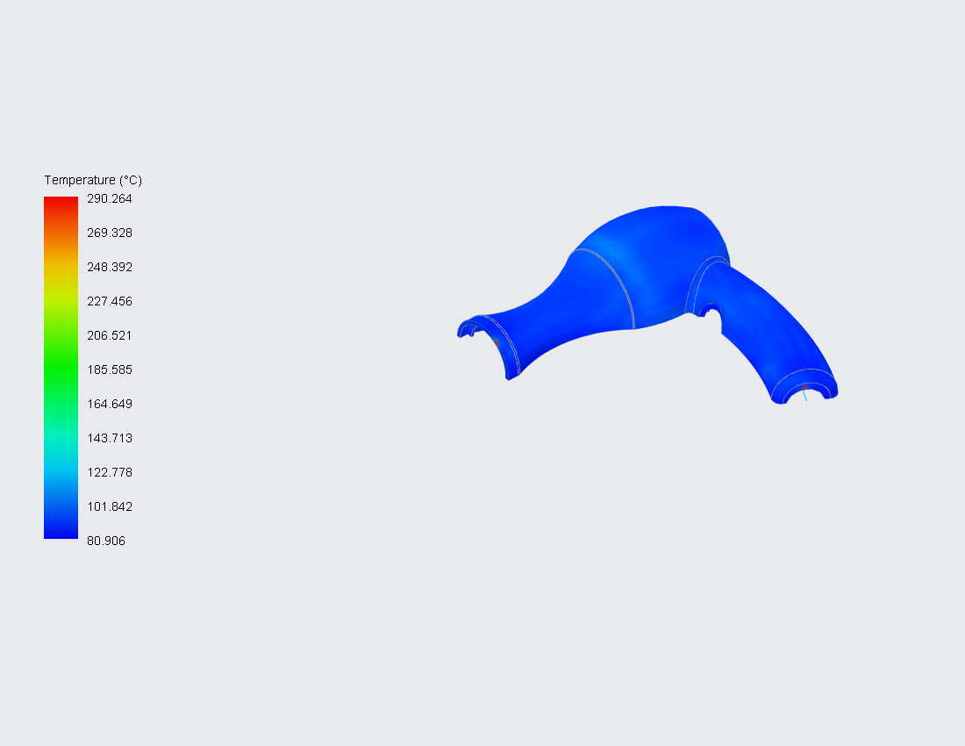
Temperature
Temperature result shows the plastic melt temperature distribution at the end of filling. The temperature distribution shows temperatures in all three dimensions for the fully cavity.

Slide 14
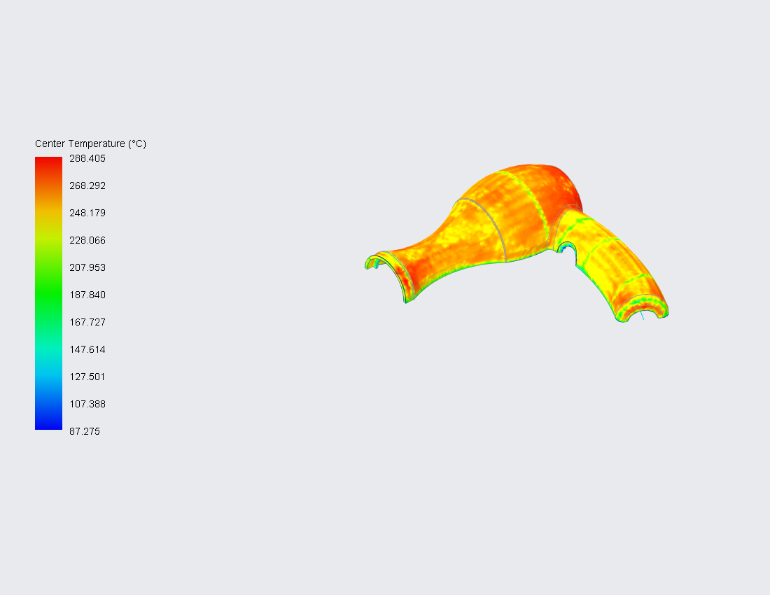
Center Temperature
Center temperature is the melt temperature of the middle layer (part line) in the thickness direction at the end of filling. Center temperature is an indicator of the thermal energy supplied to the fresh hot melt. If the center temperature is too low, flow hesitation occurs, which can cause short shot problem.

Slide 15
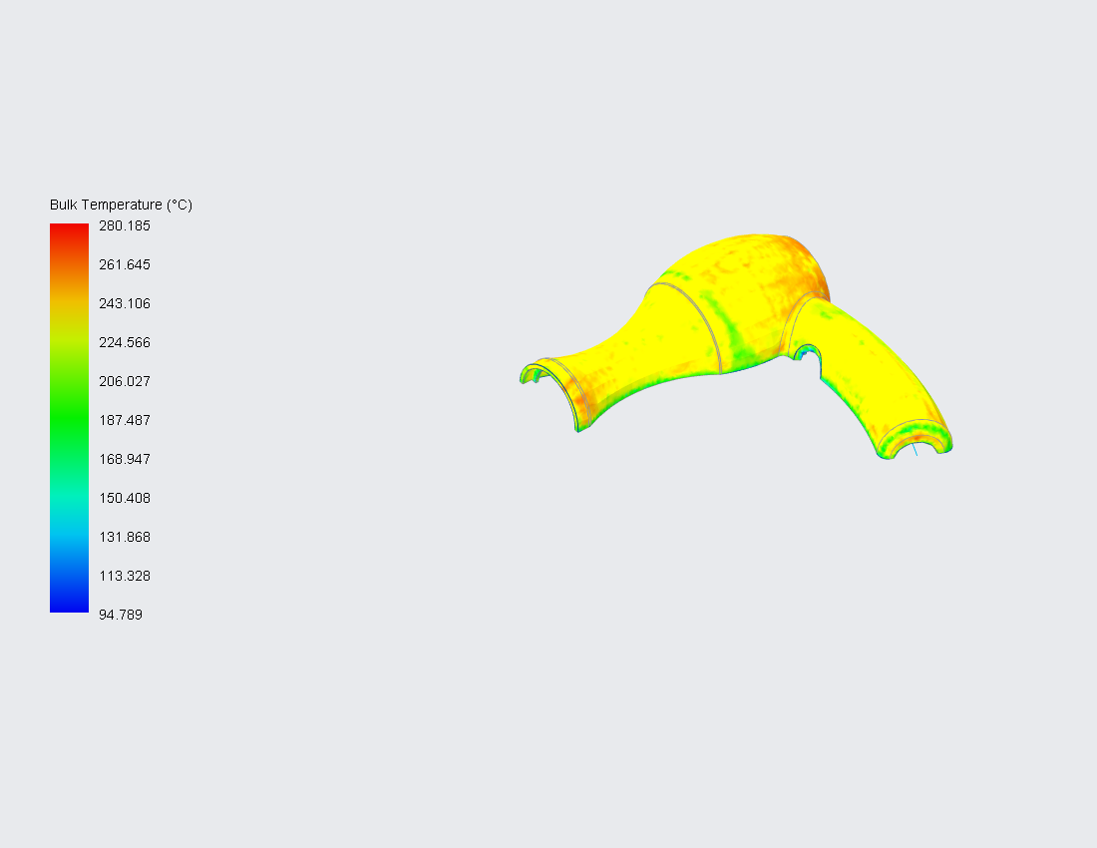
Bulk Temperature
Bulk temperature is a velocity-weighted average temperature of plastic melt across the thickness at the end of filling. The contribution from frozen layer that is stationary is ignored. The effect of heat convection and viscous heating can be displayed from this data. The bulk temperature distribution reflects the trend of the flow path.

Slide 16
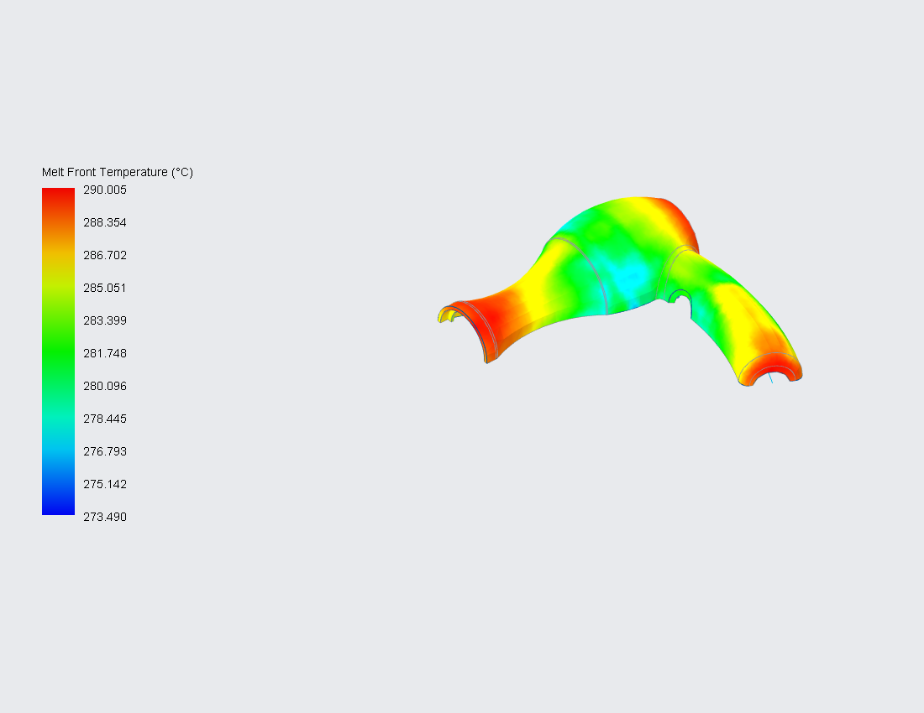
Melt Front Temperature
Melt front temperature result shows the melt temperature value recorded at the instant that it reaches the displayed position.

Slide 17
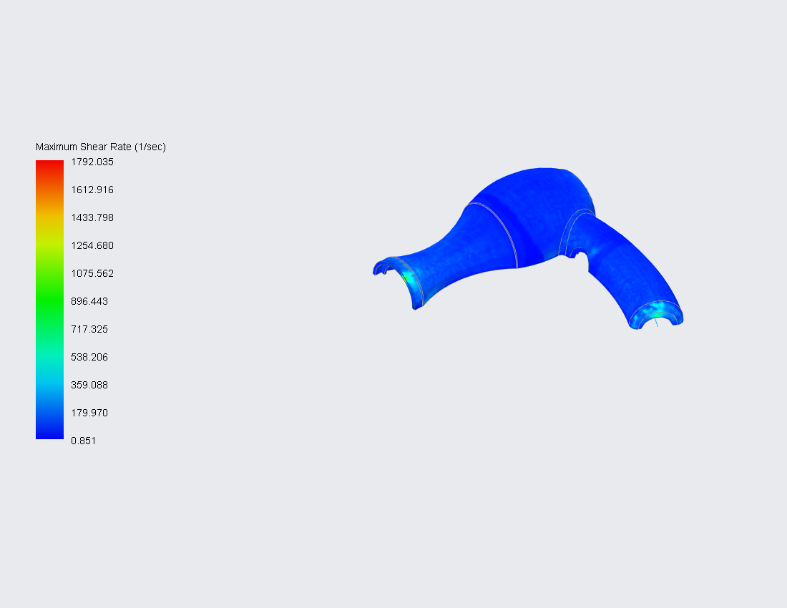
Max. Shear Rate
Maximum shear rate result shows the peak value of shear rate at each element during the filling stage.

Slide 18
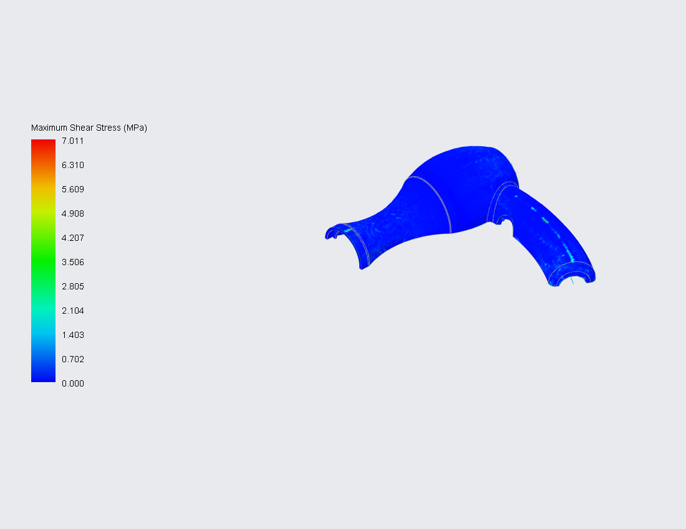
Max. Shear Stress
Maximum shear stress result shows the peak value of shear stress at each element during the filling stage.

Slide 19
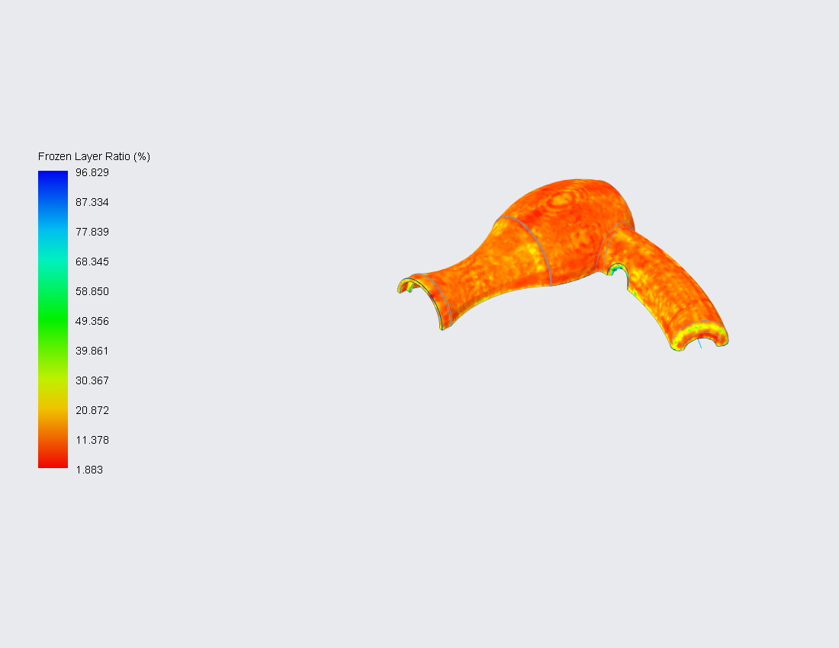
Frozen Layer Ratio
A frozen layer is formed near the cavity surface because of solidification, which is caused by cooling. The frozen ratio gradually increases with time. An increase in frozen layer ratio reduces the cross-section along the flow path and thus increases the flow resistance and sprue pressure. The frozen layer ratio also affects the residual stress and the flow-induced orientation.

Slide 20
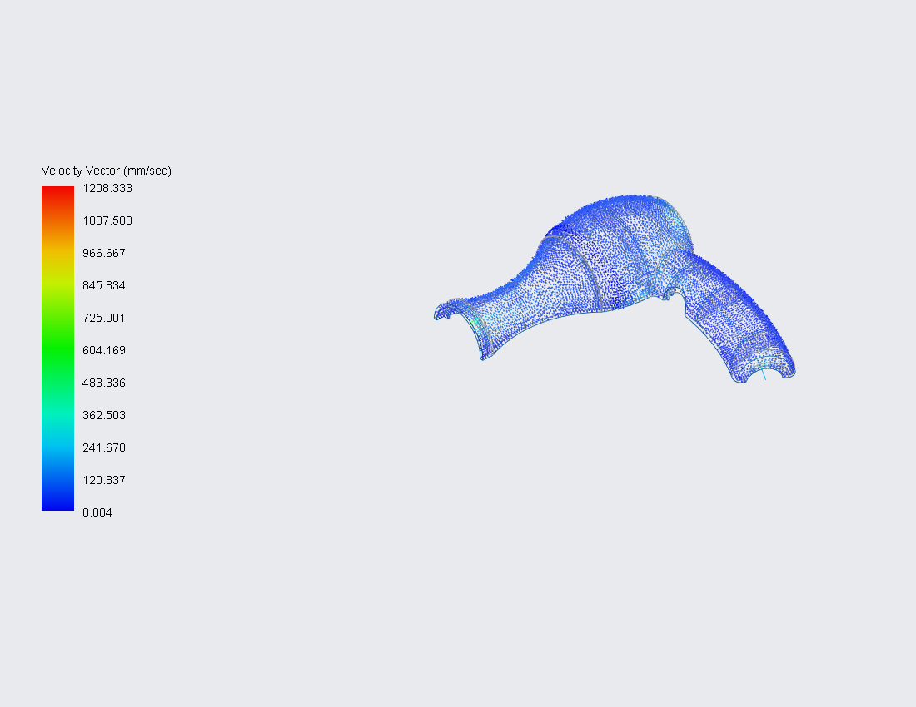
Velocity Vector
Velocity vector is the vector plot of the velocity vector at the end of filling.

Slide 21
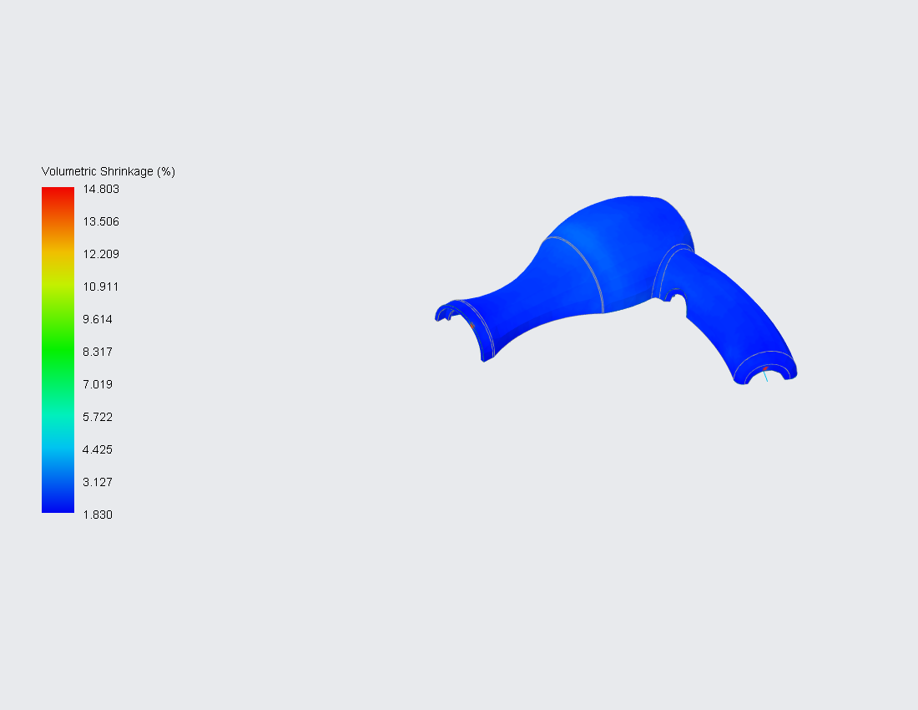
Volumetric Shrinkage
This result shows the maximum volume shrinkage across the part thickness at the end of filling.
A high positive value represents high volume shrinkage, which may cause sink mark or void.

Slide 22
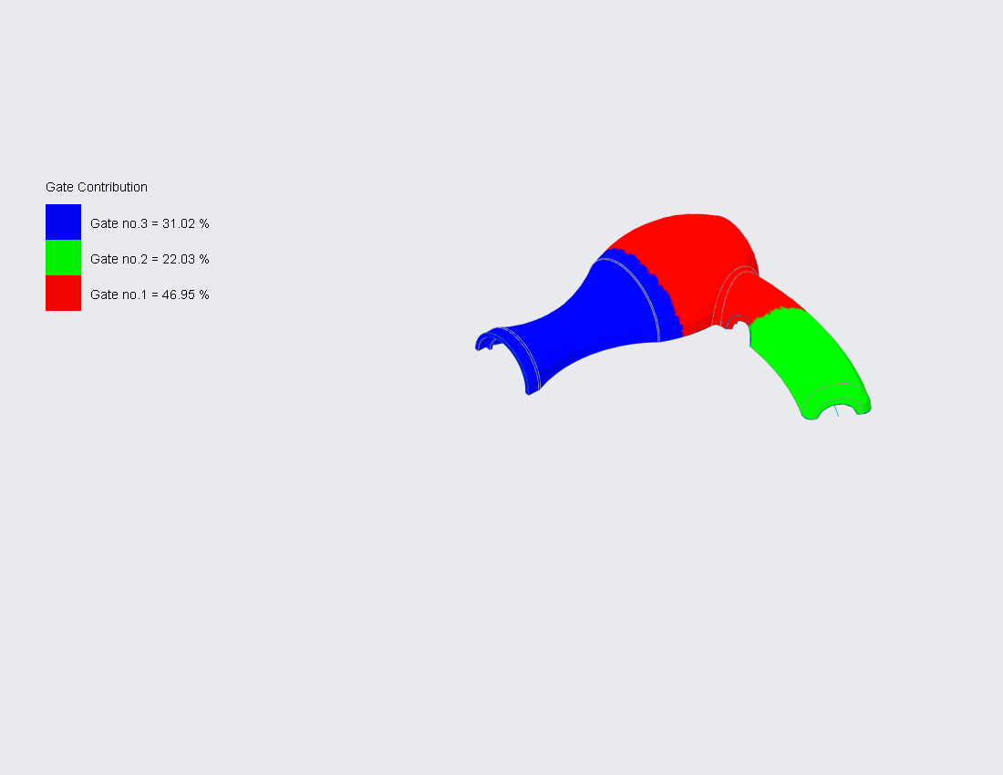
Gate Contribution
This result shows the contribution of each gate. The region in the same color represents that it was filled by the plastic from the same gate. The percentage of each color indicates its percentage of volume compared with the cavity. This result help determine whether the model was filled by balanced flow pattern.

Slide 23
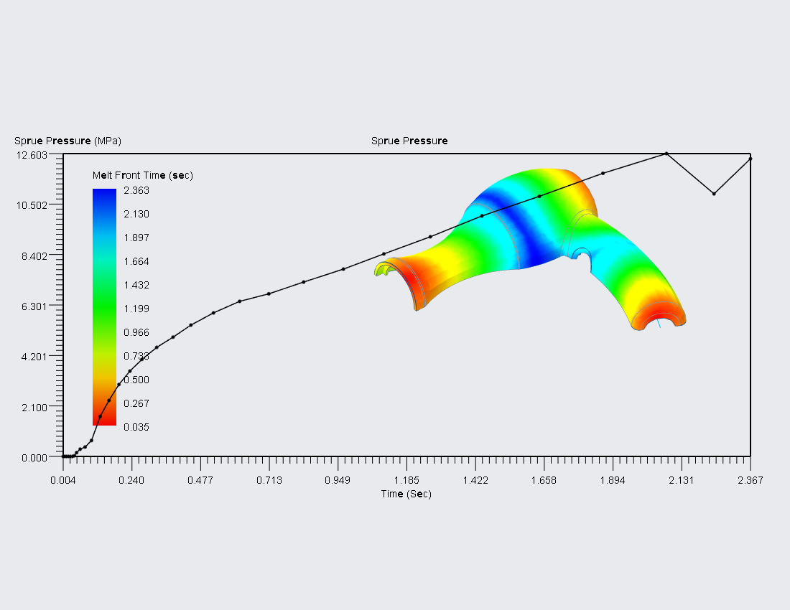
Sprue Pressure
This result shows the plot of sprue pressure versus filling time.
You can use this result to look for any unusual sprue pressure rise during filling.
If the resulting sprue pressure curve stays at the maximum allowed injection pressure, hesitation or even short shot might occur.

Slide 24
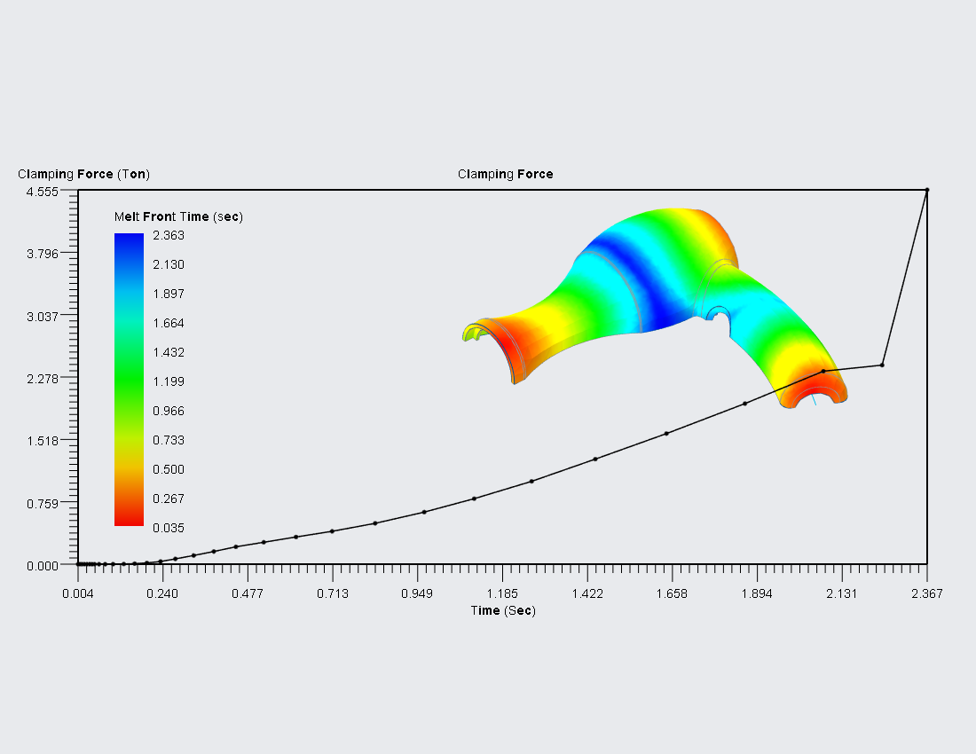
Clamping Force
This result shows a plot of the clamping force versus the filling time.
The value is the required clamping force during the molding process instead of the force that molding machine outputs.
You can use this result to identify the flash problem. If the calculated clamping force is larger than 70 percent of the machine maximum clamping force, there is a chance of plastic melt being squeezed outside the cavity and causing flash.

Slide 25
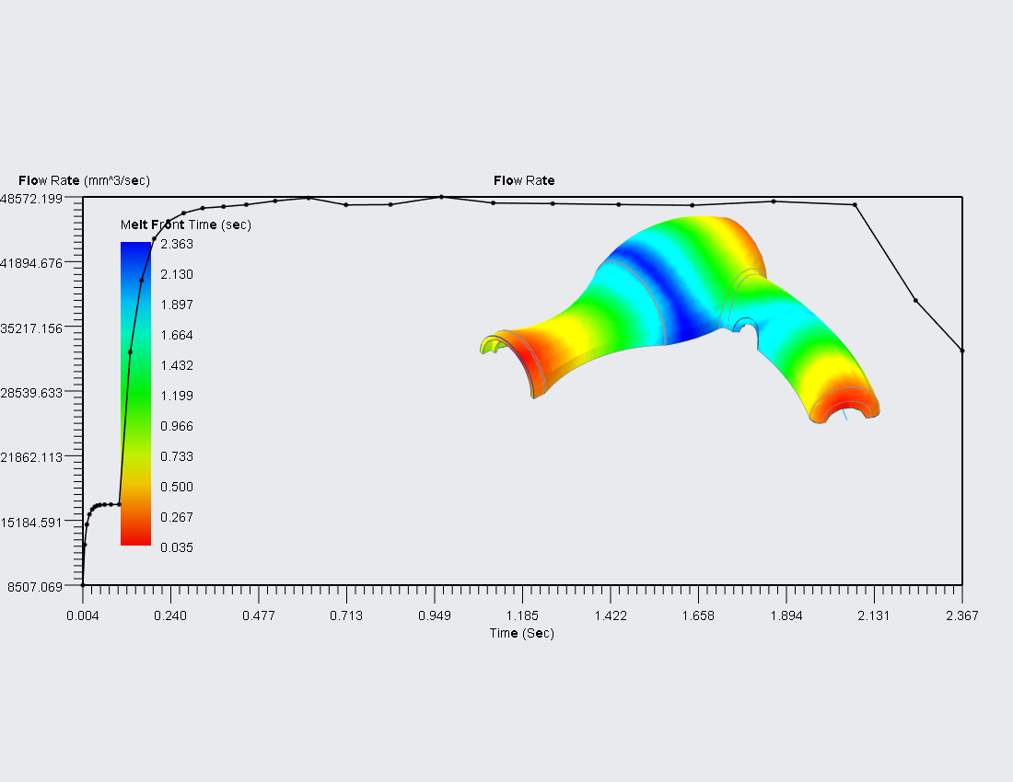
Flow Rate
This result shows the plot of flow rate at the sprue versus filling time.
In most cases, the first stage of filling is controlled by the flow rate set by the machine operator. Therefore, in this result, the flow rate usually stays at the value set in the process condition. If the resulting flow rate appears otherwise, check if the maximum allowed injection pressure is too low.

Slide 26
Result Advisor

Slide 27
Possible issues found in Analysis
Result Advisor – Weld line
Result Advisor – Air trap
Result Advisor – Unbalanced flow

Slide 28
Result Advisor – Weld line
Problem Description:
Sharp welding angles found at some places. Weld lines may become visible.
Solution:
Increase the mold temperature or melt temperature.
Decrease the filling time.
Reduce the number of gates.
Use fiber-reinforced or low viscosity material.
Increase injection speed.

Slide 29
Result Advisor – Air trap
Problem Description:
Air traps found inside the cavity. This may cause voids or surface defect.
Solution:
Increase the filling time.
Change the gate location.
Reduce the injection speed.
Modify the size or location of the vents.

Slide 30
Result Advisor – Unbalanced flow
Problem Description:
The melt contribution for each gate is unbalanced.
More plastic melt has been injected through one or more gates than the others.
Solution:
Change the gate location.
Modify the gate diameter.
Modify the model thickness.
Modify the runner design

Slide 31
Analysis Conclusions and Recommendations

Slide 32
Analysis Conclusions and Recommendations
This part can be completed by the report author

